Slide 1
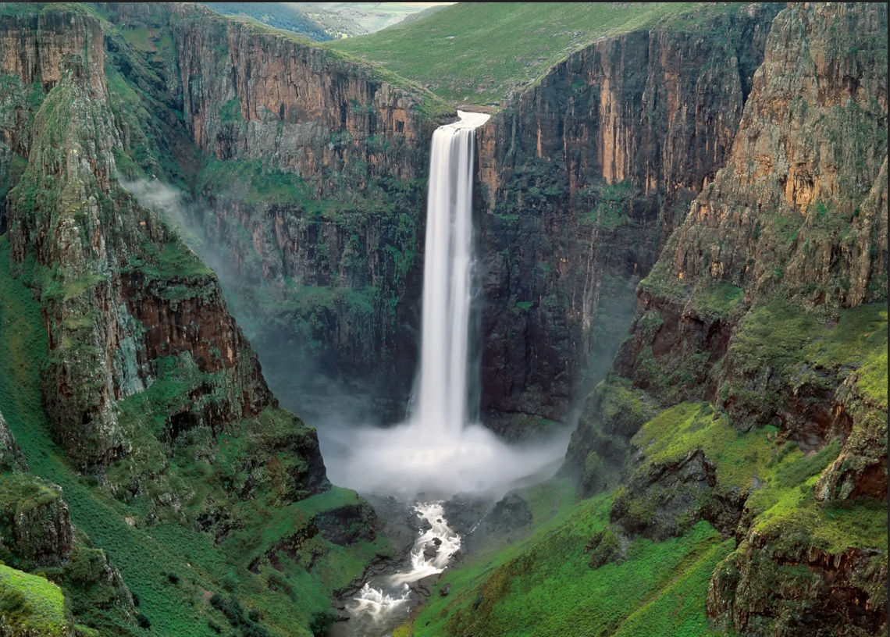
CREDIBILITY AND RELIABILITY OF GOVERNMENT BUDGETS – DOES FISCAL TRANSPARENCY MATTER?
Maleshoane Lekomola-Danziger
Budget Controller

Slide 2
INTRODUCTION
Government budgets are pivotal tools for economic management, defining planned expenditures and revenue sources over a fiscal year.
Credibility,
Reliability, and
Transparency
are crucial aspects of government budgets, impacting public trust, investment, and governance effectiveness.

Slide 3
Key pillars of economic management:
Outline planned expenditures and revenue sources, aiding resource allocation and policy implementation.
Fundamental for achieving socio-economic objectives and sectoral development.
GOVERNMENT BUDGETS

Slide 4
CREDIBILITY AND RELIABILITY
Credible budgets accurately reflect fiscal position, commitments, and intentions.
Reliable budgets adhere to sound financial principles, avoiding inconsistencies, and are based on accurate data and forecasts.

Slide 5
Fiscal Transparency Assessment for Lesotho (2023)
Budget publication: Enacted budget available, but budget proposal and end-of-year report not published promptly.
Debt information: State debt info available, but no data on major state-owned enterprise finances.
Expenditure breakdown: Executive office spending detailed.
Off-budget accounts: Exist without audit or oversight.
Military and intelligence budgets: Subject to parliamentary oversight.
Budget execution: Actual figures differ significantly from budget, no revised estimates or supplementary budget issued.
Supreme audit institution: Falls short of international independence standards but conducts comprehensive audits.
Natural resource contracts: Criteria for awards outlined but lacks public disclosure of awards.

Slide 6
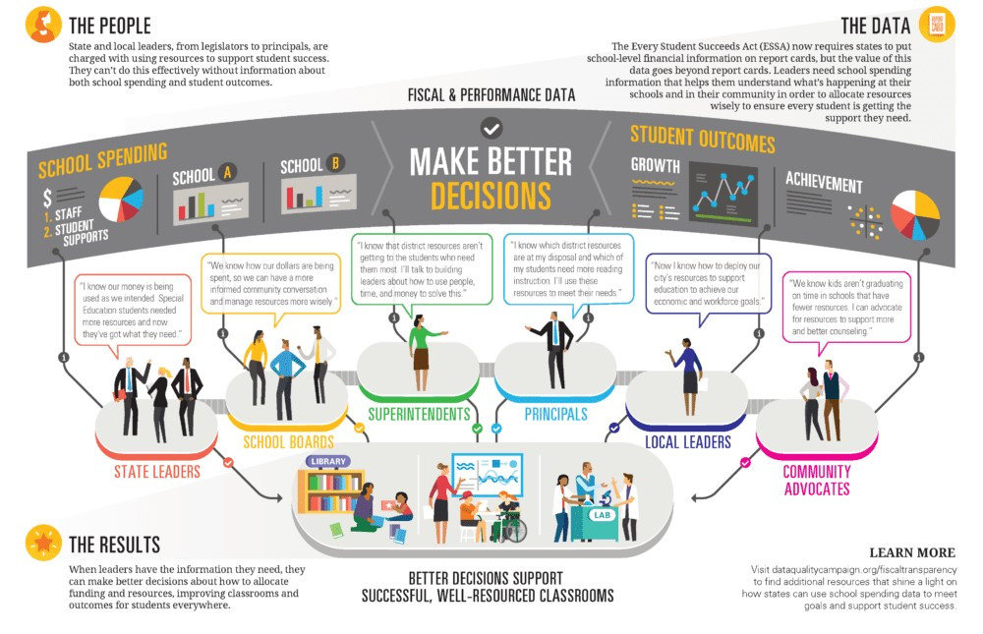
FISCAL TRANSPARENCY
A cornerstone of effective governance:
Refers to openness, clarity, and accessibility of budgetary processes and information.
Enables stakeholders to scrutinize government finances, hold policymakers accountable, and make informed decisions.

Slide 7
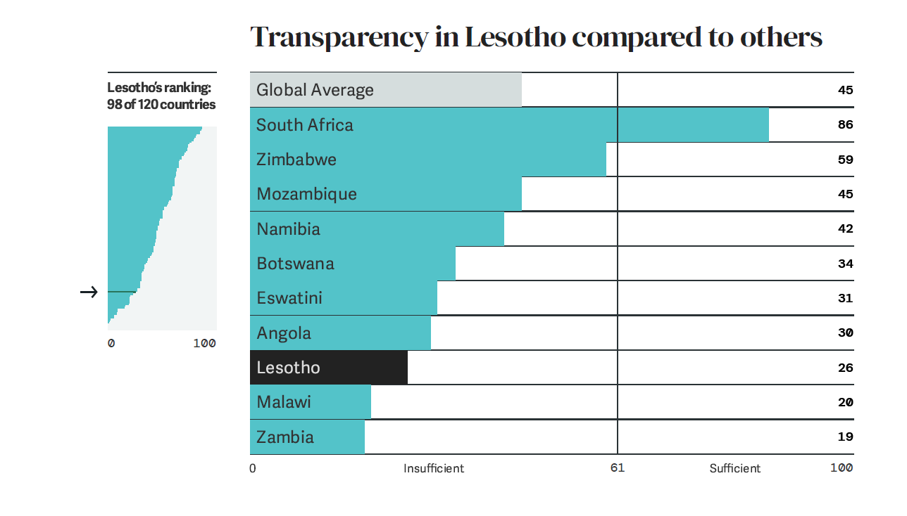
Open Budget Survey (OBS) 2021 Snapshot:
Notes:
Transparency Score: Moderate
Budget Publication: Partial - Some budget documents are published, but not all.
Budget Accessibility: Limited - Budget documents are not easily accessible to the public.
Public Participation: Limited - Limited opportunities for public engagement in the budget process.
Budget Oversight: Limited - Oversight mechanisms are weak, hindering accountability.
Fiscal Transparency: Some progress made, but significant room for improvement remains.
Recommendations: Enhance budget publication, accessibility, and public participation. Strengthen oversight mechanisms to improve fiscal transparency and accountability.

Slide 8
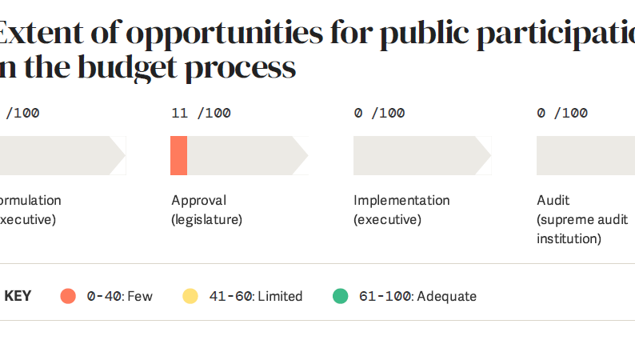
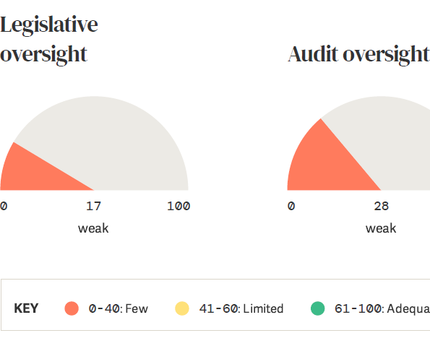

Slide 9
IMPORTANCE OF FISCAL TRANSPARENCY
Enhanced accountability: allows monitoring of public funds, reducing fiscal mismanagement and corruption.
Improved governance: promotes efficiency, effectiveness, and fairness in resource allocation.
Investor confidence: provides clear information, reducing uncertainty, attracting investment, and promoting growth.
Social cohesion: builds trust, fosters inclusive decision-making, and enhances political stability.
Effects on economic development: correlates with lower corruption, efficient resource allocation, and stronger economic performance.

Slide 10
CHALLENGES AND BARRIERS
Institutional weaknesses, lack of capacity, political resistance, and cultural factors impede fiscal transparency.
Overcoming challenges requires collaborative efforts from governments, civil society, and international partners.
Technical complexities in data collection, analysis, and dissemination can hinder transparency efforts.
Balancing the need for transparency with the protection of sensitive information can pose challenges in certain contexts.
Ensuring the independence and effectiveness of oversight mechanisms is crucial for maintaining transparency.

Slide 11
CONCLUSION
Credibility, reliability, and transparency are vital for effective economic management.
Prioritizing fiscal transparency fosters trust, attracts investment, and advances sustainable development goals.

Slide 12
THANK YOU!

Slide 13
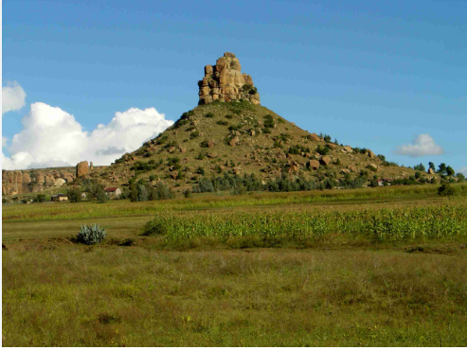
+26658642404
maleshoane.lekomola@gov.ls
+26622316409

